Slide 1
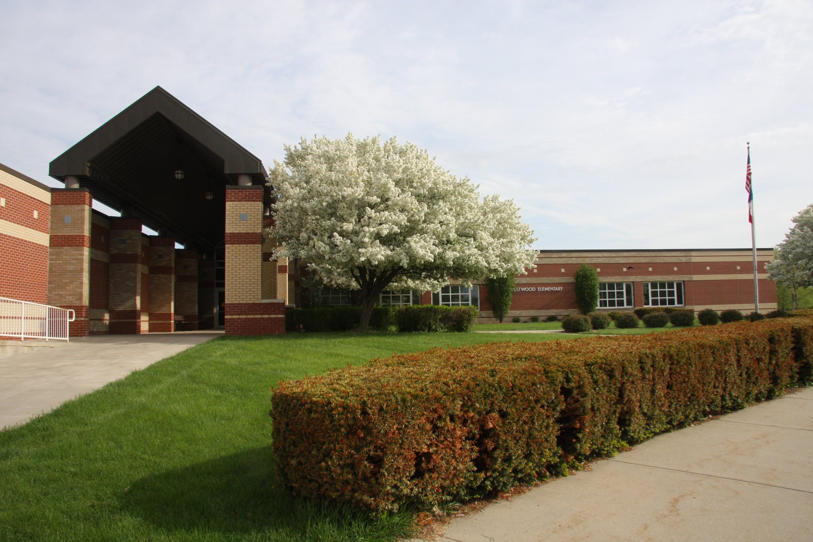
Welcome to Westwood Elementary
2020-2021 Kindergarten

Slide 2
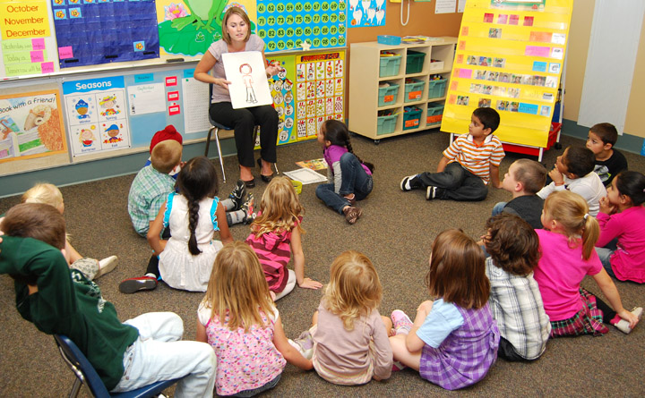
An Exciting Beginning…
Notes:
This will be an exciting time for your kindergarten child – the start of their school years. In Ankeny, we are fortunate to have a staff of the finest teachers in the Midwest. We commit to providing your child with a positive and productive kindergarten experience in a warm, caring and supportive environment.

Slide 3
Westwood Staff
Joel Martin, Principal
Erin Adair, S.A.M.
Katie VanWalbeek, Counselor
Justine Ryan, Social Worker
Michele Wright, School Nurse
Julie Dencklau, School Secretary
Katie Roland, School Secretary

Slide 4
Kindergarten Teachers
Sara Lupkes
Brianna Sell
Kelli Olson
Traci Shultice

Slide 5
Westwood Information
Model responsibility – be sure your child is in attendance and on time daily
Doors open at 7:40am
Tardy Bell at 7:55 am
Dismissal Bell at 2:55 pm
Wednesday tardy bell at 10:10 a.m. (Doors open at 9:55am)/Dismissal 2:55 p.m.
We offer a Breakfast and lunch program
We offer Before and after school programming
Communication www.ankenyschools.org

Slide 6
Access to Our Buildings
Check in through the front office
Provide a state-issued ID for scanning
Receive a printed ID badge prior to proceeding into the building
To ensure all visitors have followed the safety protocol during arrival and dismissal, parents will be asked to drop off/pick up students outside the entrances/exits and not walk back to the classroom.
Notes:
The safety and security of our students is one of our first priorities. Security experts have recommended limiting access to students during school hours as an important strategy in protecting our students. For that reason, all exterior doors are locked during school hours. Visitors will be buzzed in through a single, secure point of access via video phone doorbell. Upon entry, you will need to:

Slide 7
PBIS LIM
Positive
Behavior
Interventions
Supports
Problem Solving
Creative thinking
Accountability
Communication
Teamwork
Productivity

Slide 8
We are a Leader in Me School
Habit 1 - Be Proactive
Habit 2 - Begin with the End in Mind
Habit 3 - Put First Things First
Habit 4 - Think Win-Win
Habit 5 - Seek First to Understand Then To Be Understood
Habit 6 - Synergize
Habit 7 - Sharpen the Saw

Slide 9
Nurse’s Office
Kindergarten Health Requirements:
Certificate of Immunization
Dental Screen
Blood Lead Level Test
Vision Screen
Recommended:
Physical Examination
Contact the school nurse with any questions.
Nurse Wright: michele.wright@ankenyschools.org

Slide 10
Thursday, August 27th or Friday, August 28th First Day of Kindergarten!

